Slide 1
Supreme internect demo 4 23/08/2019 taxi boss

Slide 2
Team members
Waldo van der Merwe (Team leader, USSD, Driver App)
Joan Mwaniki (Super user, Coding Standards)
Brian Ndungu (Monitor view, User Manual)
Dewald van Hoven (Backend, Testing Policy, Integration)

Slide 3
Agenda
Slideshow
Live demo of system functionality
Q&A

Slide 4
User story
Report a traffic violation using USSD or Web
Taxi drivers receive feedback on their phones regarding reported violations
A Taxi Boss has a management system for his/her taxi drivers where he/she can keep track of their traffic violations
The Super User can get statistics and analytics regarding broader topics regarding monitors and violations

Slide 5
Why the system is boss
Automatic detection and reporting of speeding on the taxi driver phone app
Graph data displayed in both the Super User View and the Taxi Boss View
Reports are generated and exported in PDF and Spreadsheet form in the Super User view to provide data to government and large corporations

Slide 6
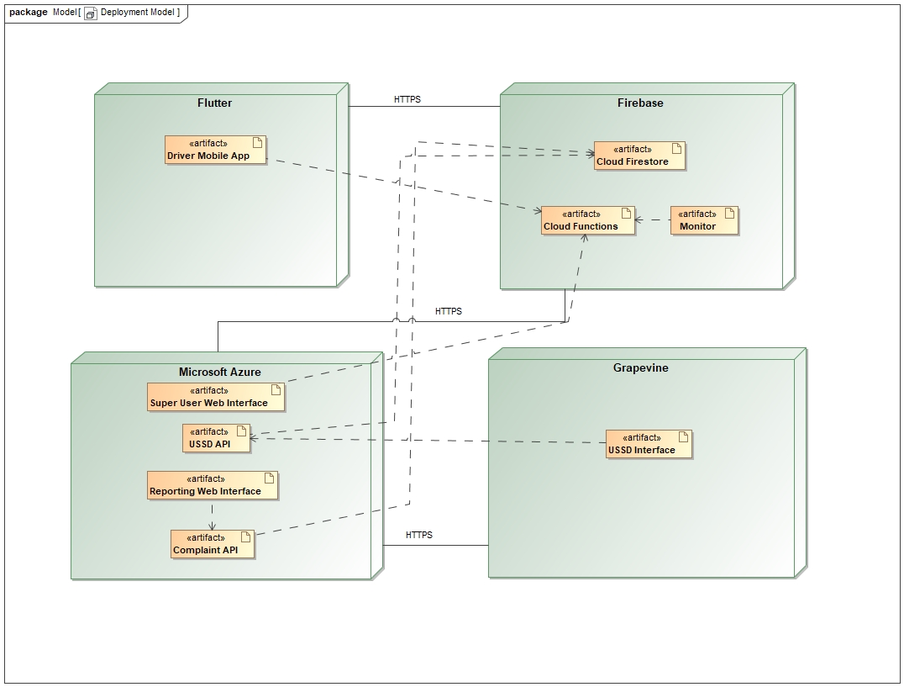

Slide 7
testing
Flutter test built in Unit Testing framework
Flutter test built in Widget Testing
Unit testing with firebase
Integration testing with Travis CI

Slide 8
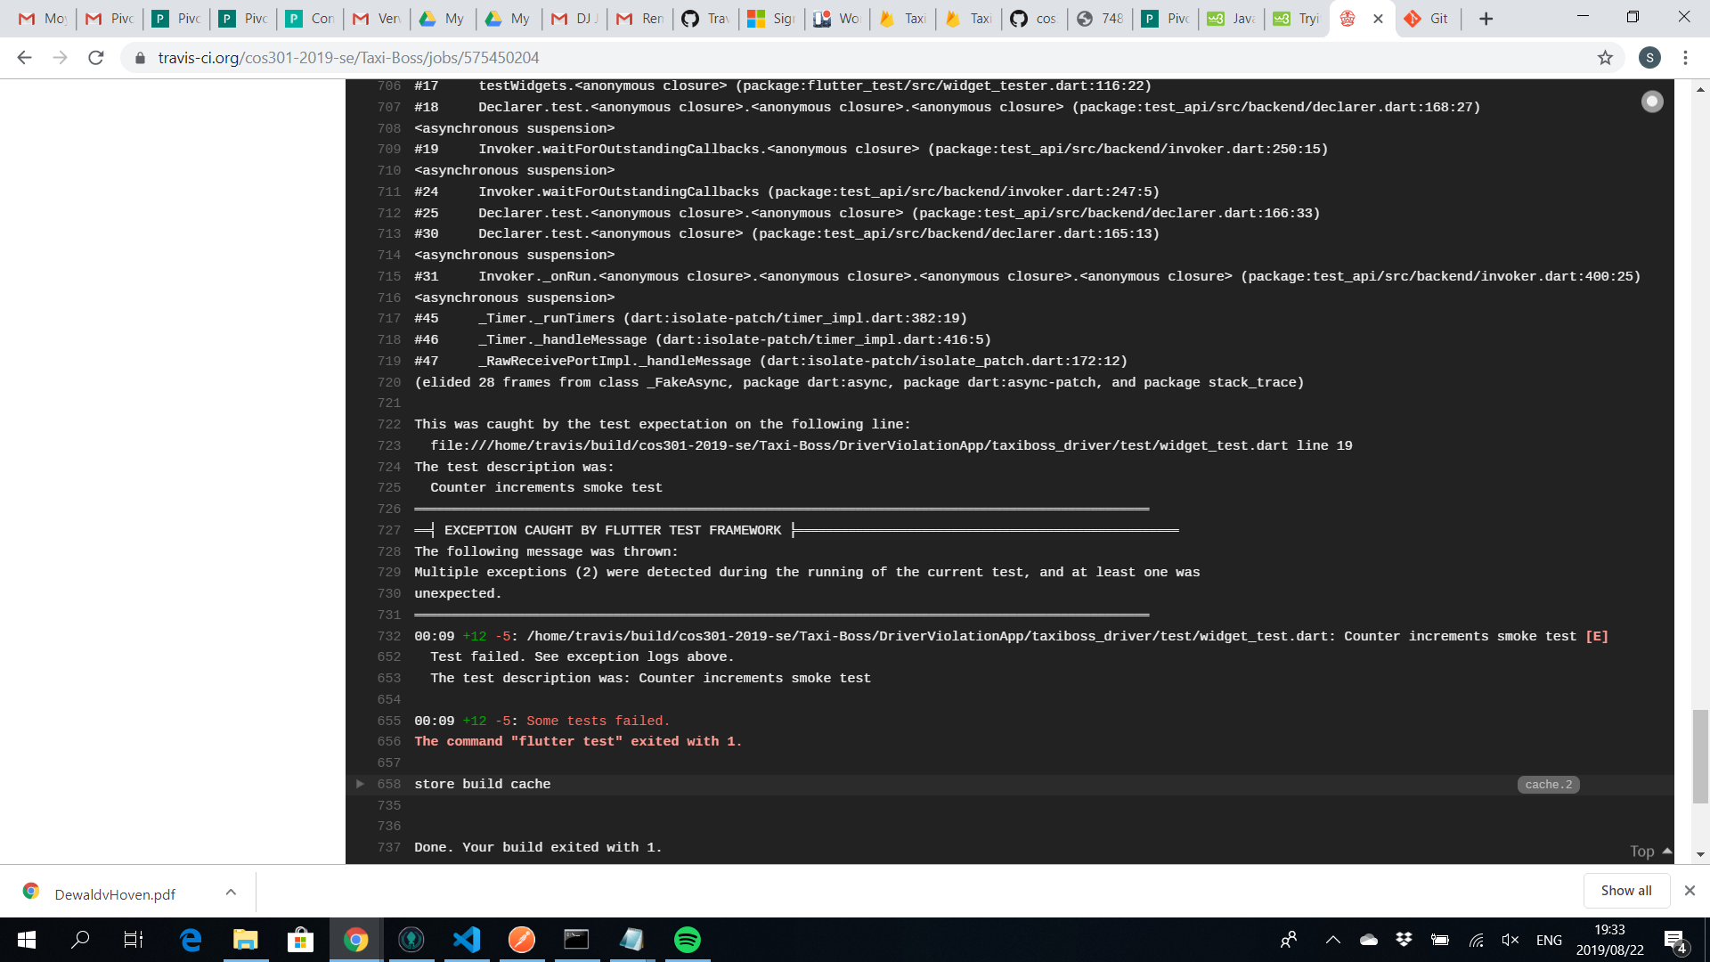

Slide 9

What is left to be implemented
Data validation for driver registration
Add more graphs to super user website
Add more flexibility in personalized graph generation
Smoother running speedometer on taxi driver app

Slide 10


Slide 11

Any questions?
This Photo by Unknown Author is licensed under CC BY-NC-ND

Slide 12
The End

